Slide 1
CRISPR gRNA designer to evaluate off-target effects
By Gopalakrishnan Kumar, MTech IIT-Bombay,
Freelance Data Science Consultant
LinkedIn: Profile Link : https://www.linkedin.com/in/gopalakrishnankumar-a73301110/
Github:https://github.com/Gopal21236/
Kaggle URL- https://www.kaggle.com/gopalkk2

Slide 2
Google Colab URL
https://colab.research.google.com/drive/1lXNPxhAvD--WZ0jRfF8tUcJkbANlYgem?usp=sharing

Slide 3
Abstract
The CRISPR-Cas9 system has emerged as a revolutionary genome editing technology, enabling precise modification of DNA sequences. A critical component of this system is the guide RNA (gRNA), which directs the Cas9 enzyme to a specific genomic location. However, unintended edits, known as off-target effects, pose significant challenges to its safe application. This study presents a computational framework for designing gRNAs and evaluating their off-target potential using sequence analysis techniques. The approach includes identification of candidate gRNAs, genome-wide mismatch analysis, and scoring mechanisms to rank guide efficiency and specificity.

Slide 4
Introduction
The CRISPR-Cas9 system has transformed molecular biology by enabling targeted genome editing with high efficiency. It consists of two main components:
Cas9 nuclease
Guide RNA (gRNA)
The gRNA binds to a complementary DNA sequence adjacent to a Protospacer Adjacent Motif (PAM), typically NGG for SpCas9, directing Cas9 to introduce double-strand breaks.
Despite its precision, CRISPR-Cas9 can bind to sequences with partial mismatches, leading to off-target effects, which may result in unintended mutations and potential safety risks.

Slide 5
Objectives
The objectives of this study are:
To design candidate gRNAs from target DNA sequences
To identify potential off-target sites across the genome
To quantify mismatch-based similarity
To develop a scoring mechanism for ranking gRNAs
To provide a computational framework for safe genome editing

Slide 6
Background
Existing tools like:
CRISPOR
CHOPCHOP
provide advanced off-target prediction using machine learning and
genome-wide indexing. However, they are often:
Complex
Computationally intensive
Less customizable
This project provides a lightweight and customizable alternative for educational and research purposes.

Slide 7
Background
3.1 gRNA Design Principles
A typical gRNA consists of:
A 20-nucleotide guide sequence
A PAM sequence (e.g., NGG)
Key considerations include:
GC content (optimal: 40–60%)
Avoidance of repetitive sequences
Minimization of secondary structures

Slide 8
Background
3.2 Off-Target Effects
Off-target effects occur when the gRNA binds to sequences that are similar but not identical to the intended target. Factors influencing off-target binding include:
Number of mismatches
Position of mismatches (seed region sensitivity)
Chromatin accessibility

Slide 9
Background
3.3 Scoring Methods
Common scoring approaches include:
MIT score (position-weighted mismatches)
CFD score (Cutting Frequency Determination)
Simple mismatch penalty models

Slide 10
Methodology
Step 1: Input Data
Target DNA sequence (FASTA format)
Reference genome sequence
Step 2: gRNA Candidate Identification
Using pattern matching:
Extract all 20 bp sequences followed by PAM (NGG)
Identify candidates on both forward and reverse strands

Slide 11
Background
3.3 Scoring Methods
Common scoring approaches include:
MIT score (position-weighted mismatches)
CFD score (Cutting Frequency Determination)
Simple mismatch penalty models

Slide 12
Methodology
Step 1: Input Data
Target DNA sequence (FASTA format)
Reference genome sequence
Step 2: gRNA Candidate Identification
Using pattern matching:
Extract all 20 bp sequences followed by PAM (NGG)
Identify candidates on both forward and reverse strands

Slide 13
Methodology
Step 3: Off-Target Search
For each candidate gRNA:
Slide a window across the genome
Compare sequences of equal length
Count mismatches
Criteria:
Allow up to 3 mismatches

Slide 14
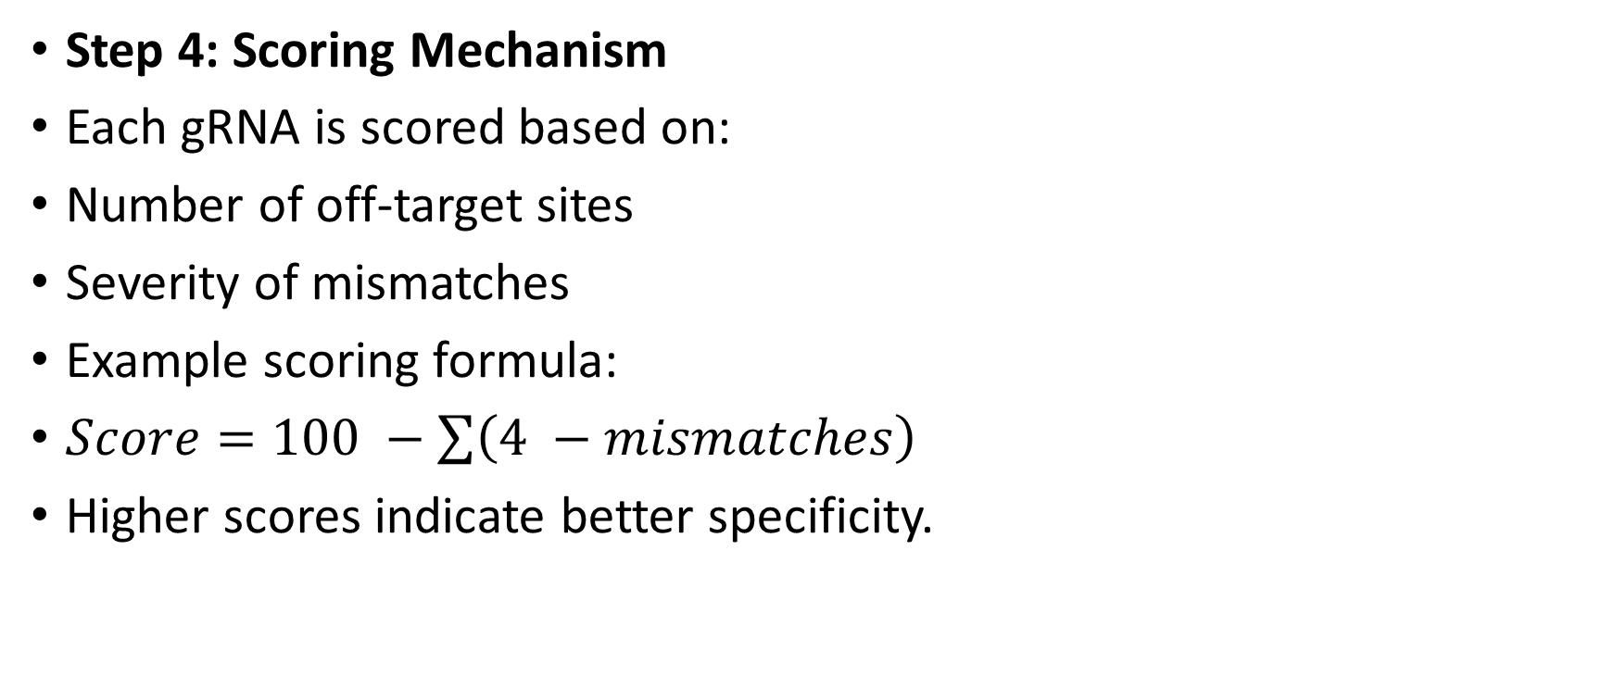
Methodology
Step 4: Scoring Mechanism
Each gRNA is scored based on:
Number of off-target sites
Severity of mismatches
Example scoring formula:
$Score=100 −\sum{\left(4 −mismatches\right)}$
Higher scores indicate better specificity.

Slide 15
Methodology
Step 5: Ranking and Selection
Rank gRNAs based on scores
Select top candidates with minimal off-target effects

Slide 16
Implementation (Python Overview)
Key components of the implementation include:
Sequence parsing using BioPython
Regular expression-based PAM detection
Mismatch counting functions
Genome-wide scanning
Sorting and ranking results

Slide 17
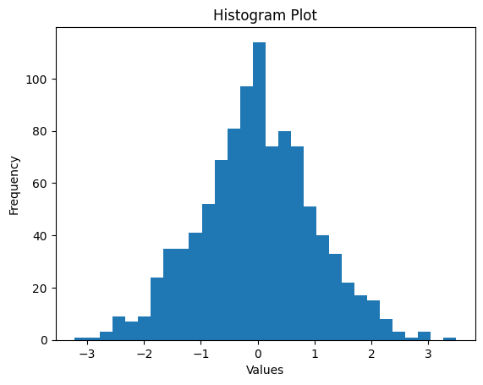
Data Visualization

Slide 18
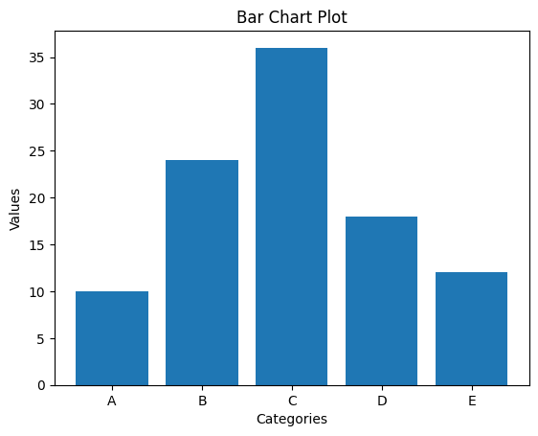
Data Visualization

Slide 19
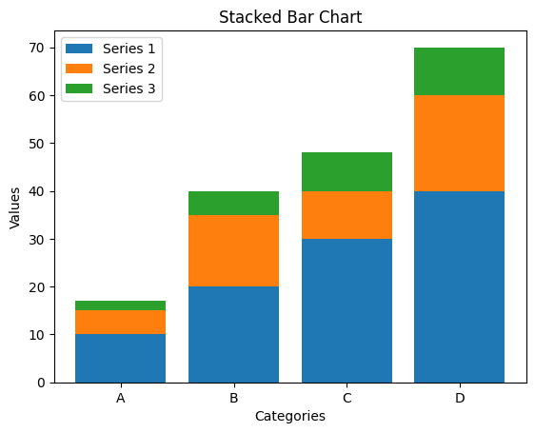
Data Visualization

Slide 20
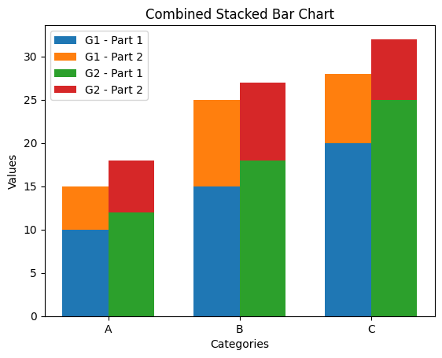
Data Visualization

Slide 21
Results and Analysis
The computational pipeline produces:
List of candidate gRNAs
Number of off-target matches per guide
Specificity score
Observations:
gRNAs with fewer mismatches show higher specificity
Guides targeting unique regions perform better
Some sequences exhibit multiple off-target sites, reducing reliability

Slide 22
Discussion
The study highlights the importance of computational screening in CRISPR applications. While experimental validation is essential, in silico methods significantly reduce the search space and improve efficiency.
Advantages of the proposed approach:
Simple and interpretable
Adaptable to different genomes
Scalable with optimization

Slide 23
Limitations
Brute-force genome scanning is computationally expensive
Does not consider bulges (insertions/deletions)
Ignores chromatin accessibility and epigenetic factors
Simplified scoring model

Slide 24
Future Work
Potential improvements include:
Integration with alignment tools (e.g., Bowtie, BWA)
Implementation of CFD/MIT scoring models
Machine learning-based efficiency prediction
Development of web-based tools for accessibility

Slide 25
Applications
Gene therapy
Functional genomics
Drug target validation
Agricultural biotechnology

Slide 26
Conclusion
This study presents a computational framework for designing CRISPR gRNAs and evaluating off-target effects. The approach enhances the safety and reliability of genome editing by prioritizing highly specific guide RNAs. With further optimization, this framework can be extended into advanced bioinformatics pipelines and real-world applications.

Slide 27
References
CRISPR-Cas9 Research Papers
Genome Editing Reviews
BioPython Documentation
Computational Biology Resources

